Slide 1
FINAL
Supermarket Management System
Mengting Yang

Slide 2
CONTENTS
Part 1
Part 2
Part 3
Part 4
Introduction
Main Tables
Relations
Functions

Slide 3
Part 1
Introduction

Slide 4
Introduction
This is a supermarket management system to manage the SUPPLIER, INVENTORY and CUSTOMER of the supermarket.
The supermarket first need to bought PRODUCTS from different suppliers and the products will be the inventory items of the supermarket.
Then the supermarket will SELL the inventory items to different customers to complete the trade.

Slide 5
Part 2
Main Tables

Slide 6
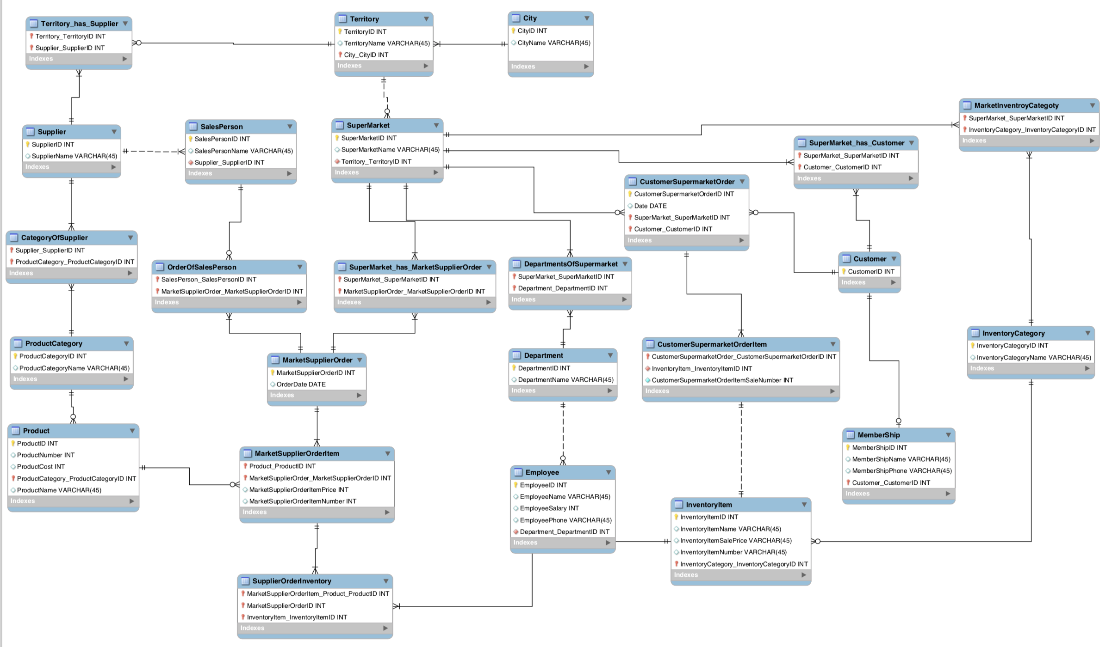

Slide 7
Supermarket Part

Slide 9
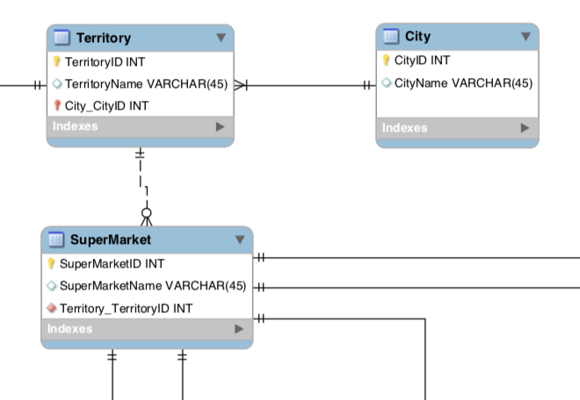
Supermarket Part
One City must have at least one Territory
One Territory can have but not must have many Supermarkets

Slide 10
Supplier Part

Slide 12
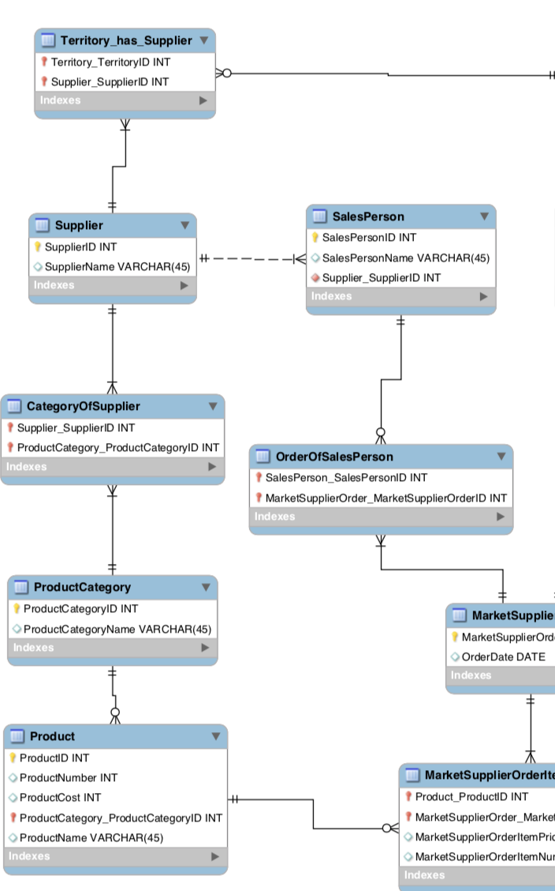
Supplier Part
One Territory can have many Suppliers and one Supplier can serve many Territories
One Supplier has many Sales Person to sell the products to Supermarkets.
One Supplier has many Categories of the products and one Category has many Products in it.

Slide 13
Employee Part

Slide 15
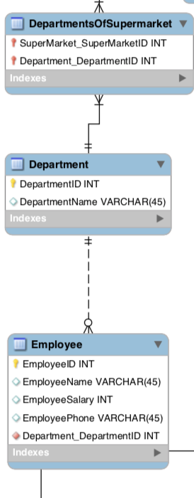
Employee Part
One Supermarket has many Departments for different
responsibilities and in one Department there will be many Employees.

Slide 16
Customer Part

Slide 18
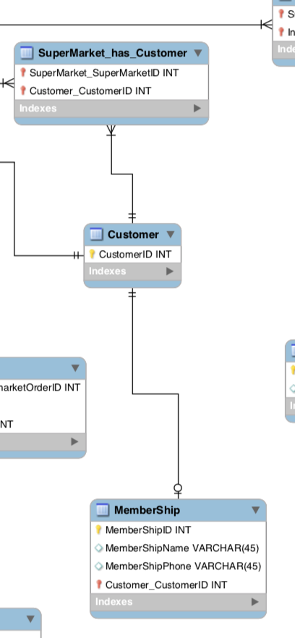
Customer Part
One Supermarket has many Customers
(for now, we don’t need to know the name of the customer)
Some of the Customers will become the Membership so we can have the information for them.

Slide 19
Inventory Part

Slide 21
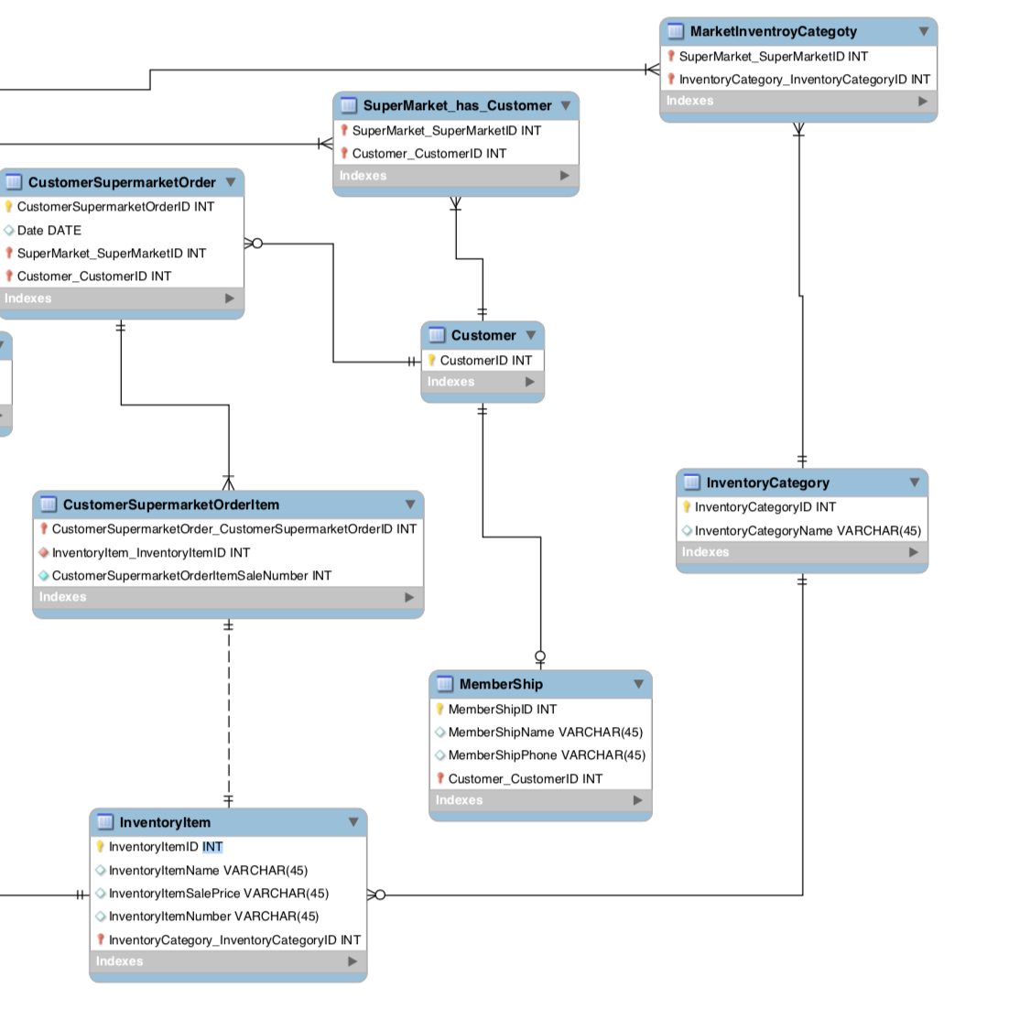
Inventory Part
One Supermarket has many Inventory Categories and each Category can belong to many Supermarkets.
One Inventory Category can have many Inventory Item

Slide 22
Part 3
Relations

Slide 23
Supplier and Supermarket

Slide 25
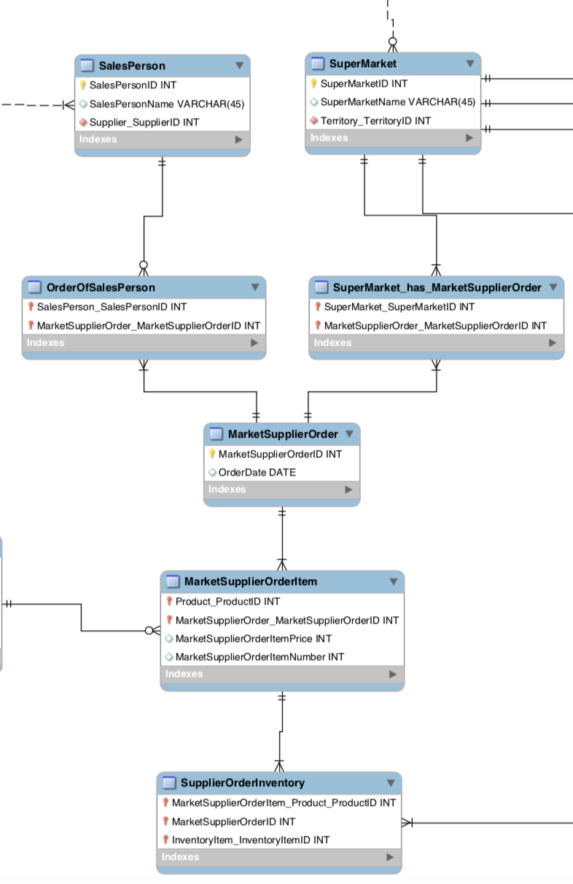
Supplier and Supermarket
Supplier sells the products by Sales Person to Supermarket.
One Supermarket can have many Orders with many Sales Person. At the same time, one Sales Person can also sell many Products to many Supermarkets.

Slide 26
Supplier and Supermarket
There are two kinds of Orders
One can be seen from Sales Person aspect
the other one can be seen from Supermarket aspect
So they can check and manage their own orders separately.

Slide 27
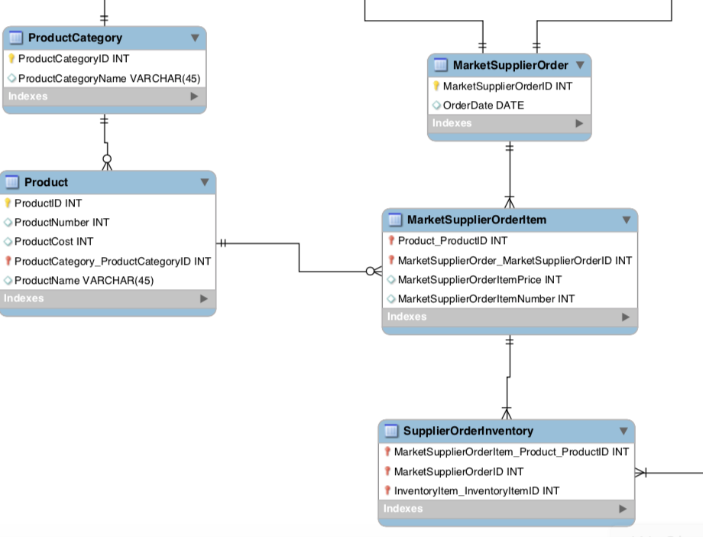
Supplier and Supermarket
One Order must have one or more Order Item
For the Order Item, from the Supplier aspect, one Order Item will be one Product of the Supplier
from the Supermarket aspect, after bought these Order Item, they will become the Inventory Item of the Supermarket

Slide 28
Supermarket and Customer

Slide 30
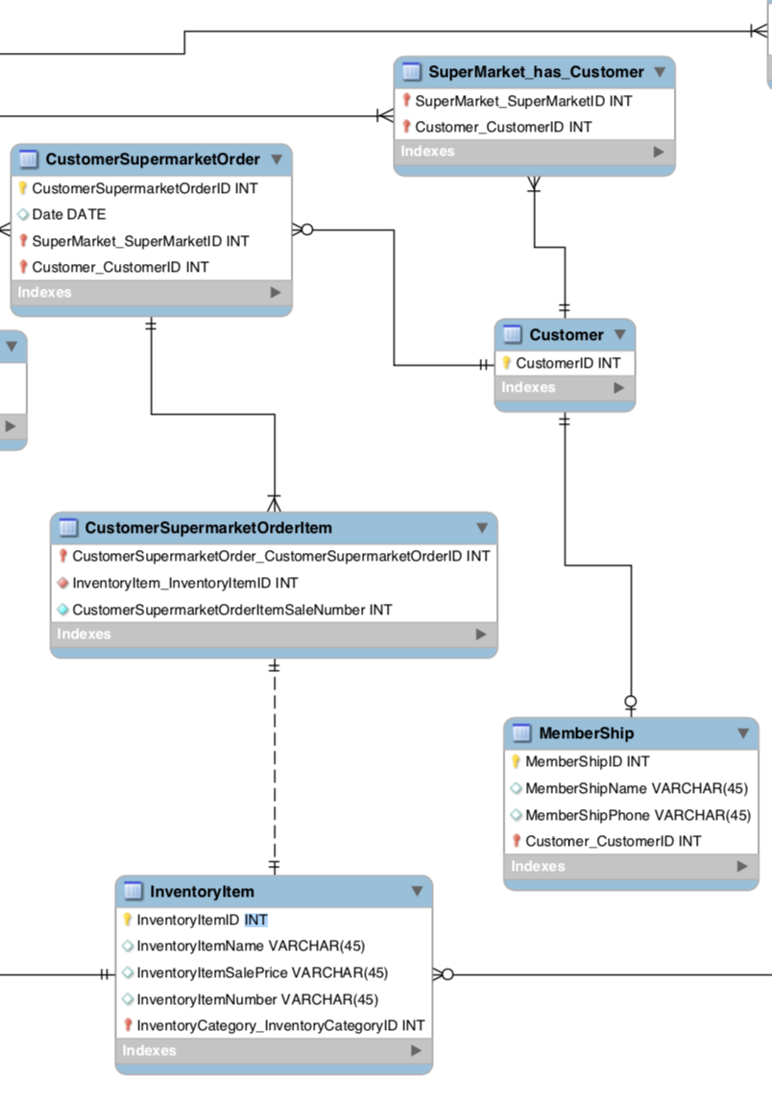
Supermarket and Customer
One Supermarket can have Orders with many Customers and one Customer can also have Orders with many different Supermarkets.
One Order must have at least one Order Item
and actually, the Order Item is the Inventory Item of the Supermarket.

Slide 31
Part 4
Functions

Slide 32
View

Slide 33
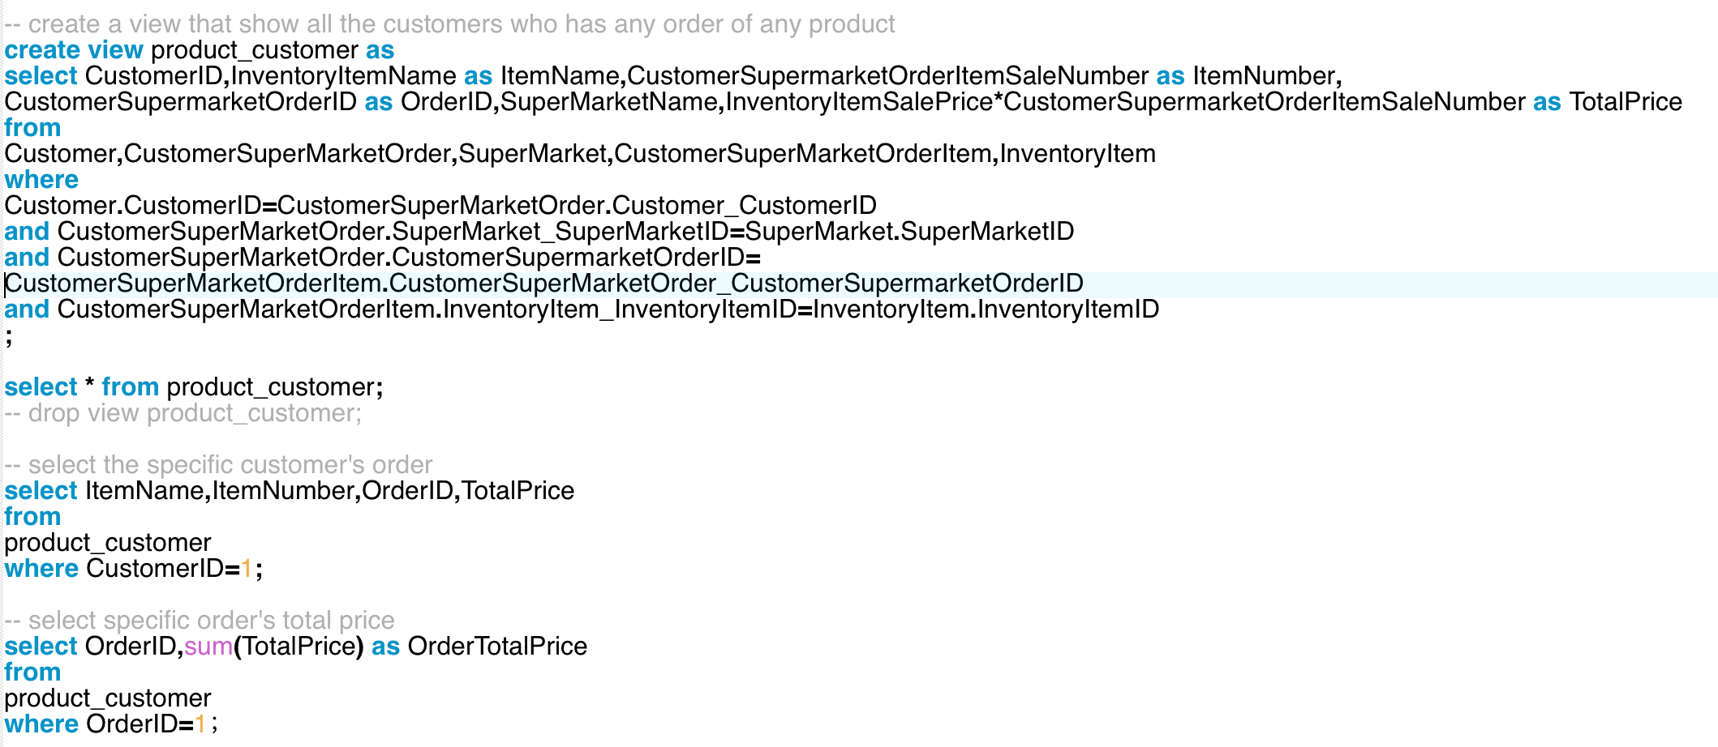
View 1:View of Orders
show all the Customers who has any Order of any Product

Slide 34
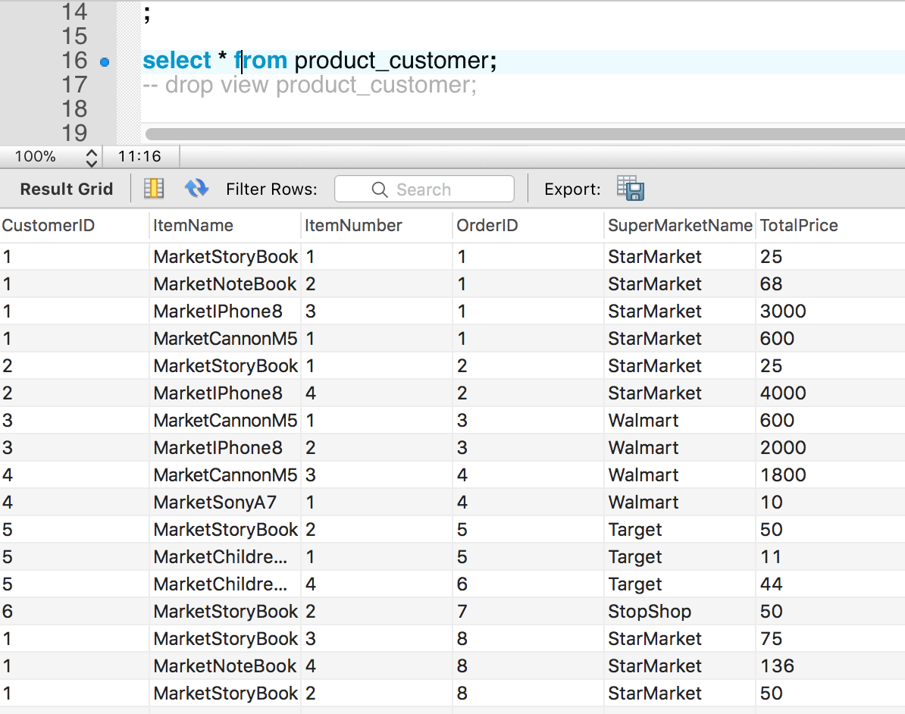

Slide 35
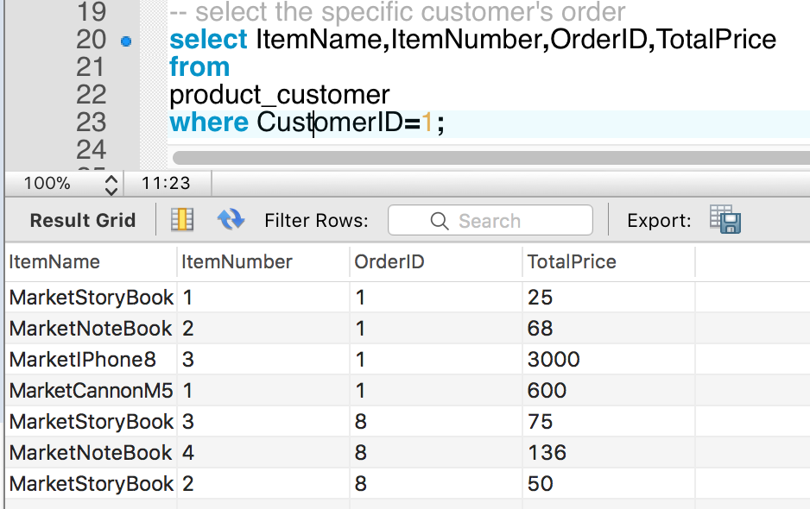
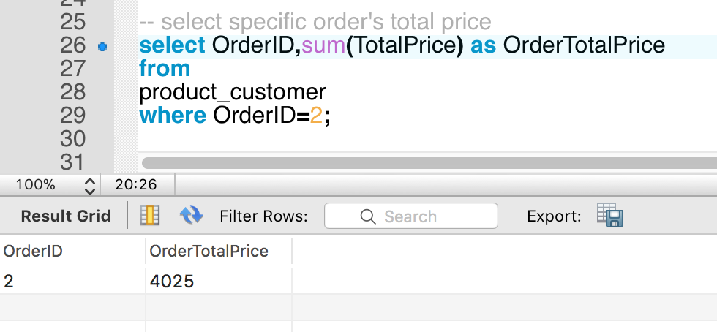
Select specific customer’s Order
Select specific order's Total Price

Slide 36
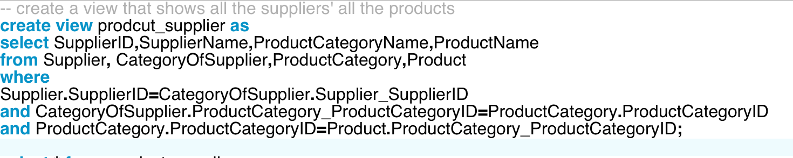
View 2:View of Products
show all the suppliers' all the products

Slide 37
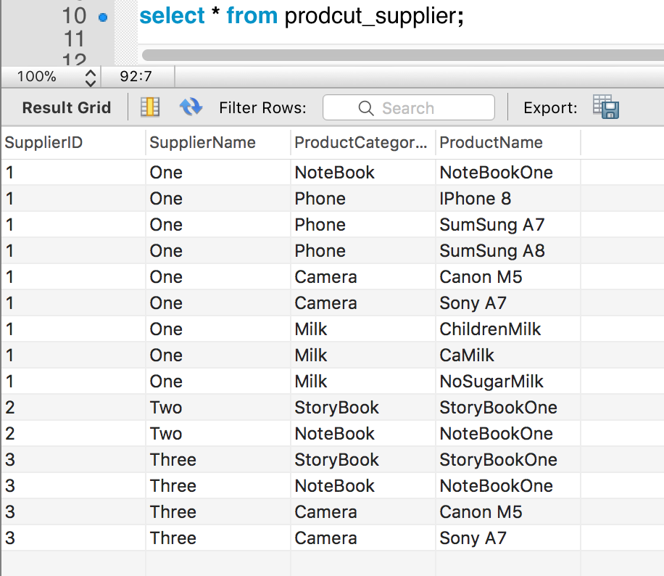

Slide 38
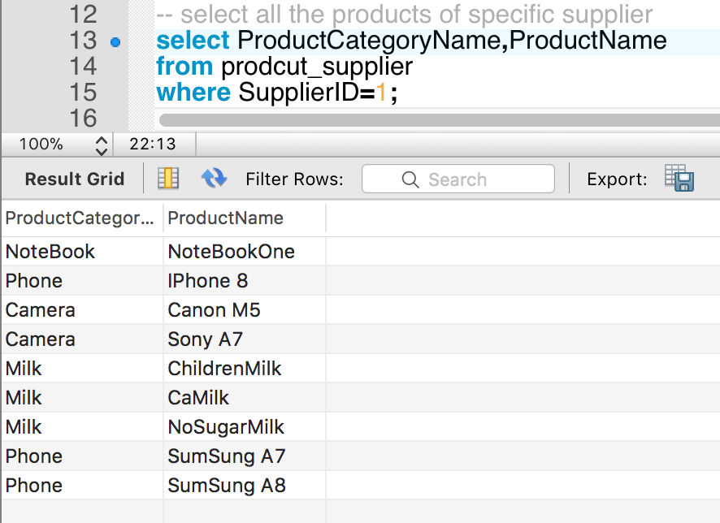
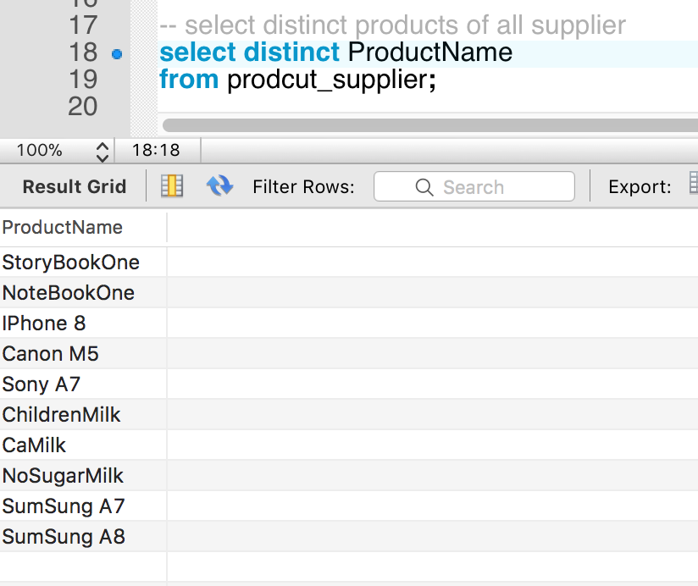
Select all the products of specific supplier
Select distinct products of all supplier

Slide 39
Procedure

Slide 40
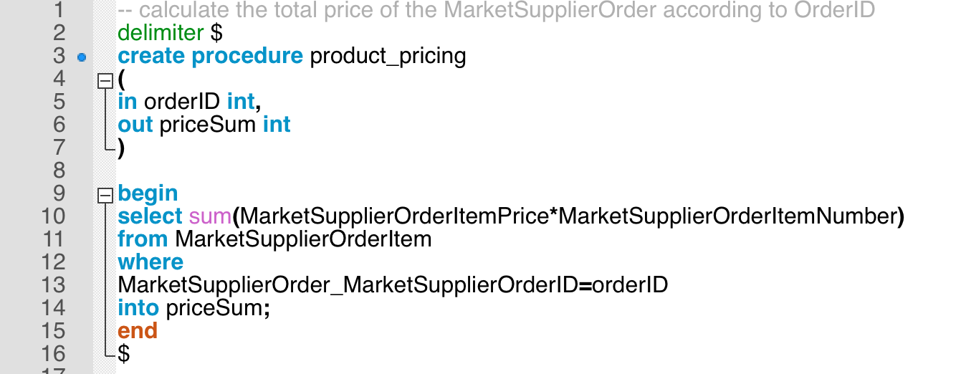
Procedure 1: Calculate Total Price
Calculate the Total Price of the Market Supplier Order according to Order ID

Slide 41
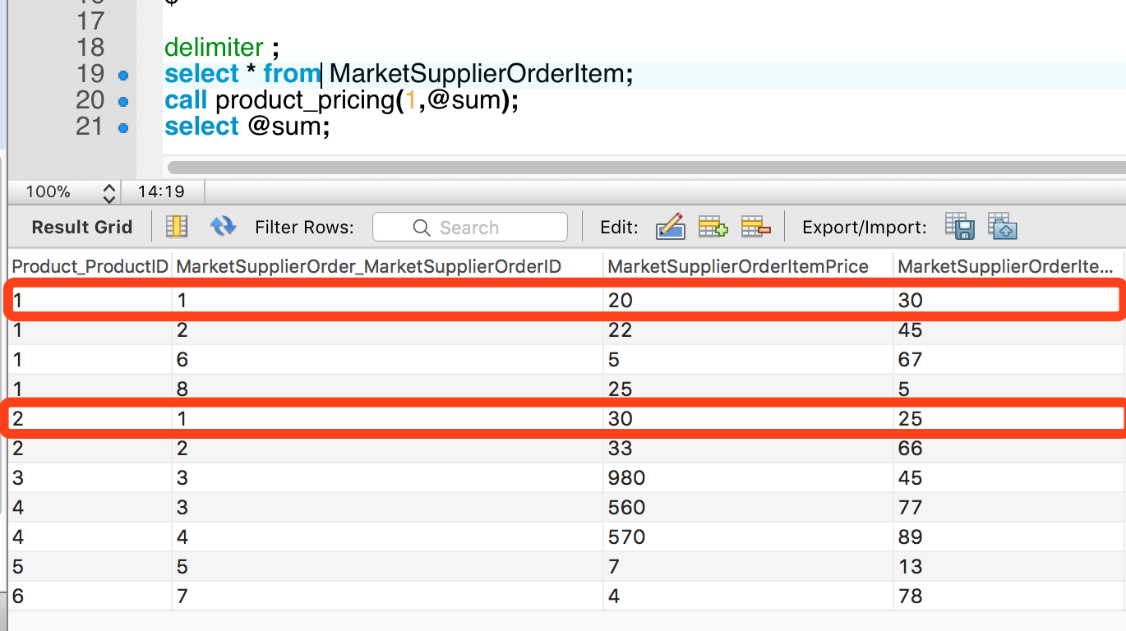
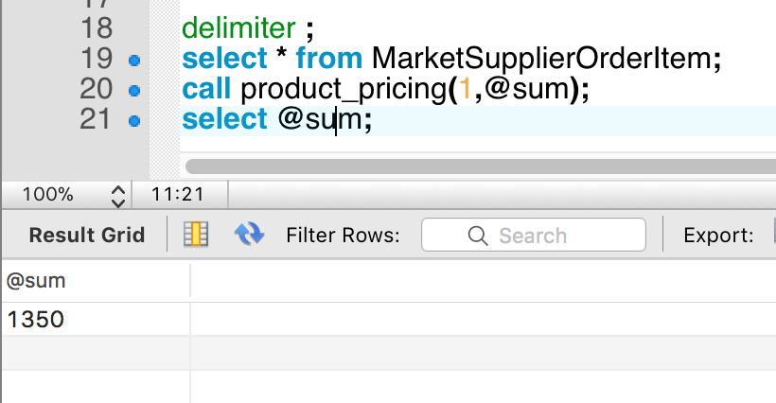

Slide 42
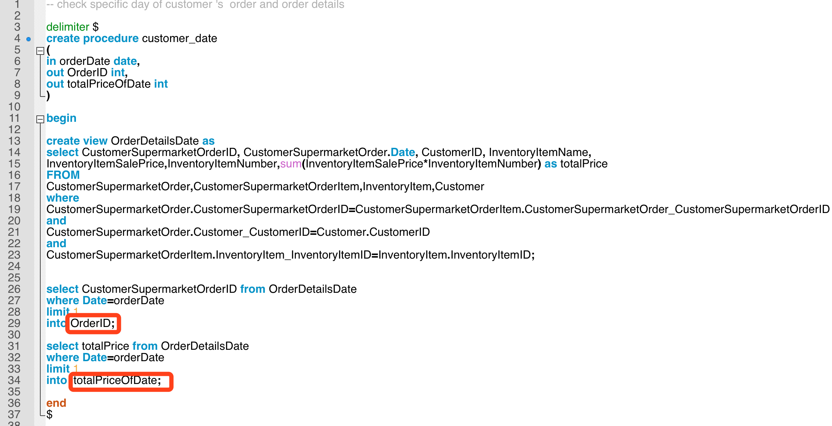
Procedure 2: Check Order of Specific Day
Check specific day of customer 's order and order details

Slide 43
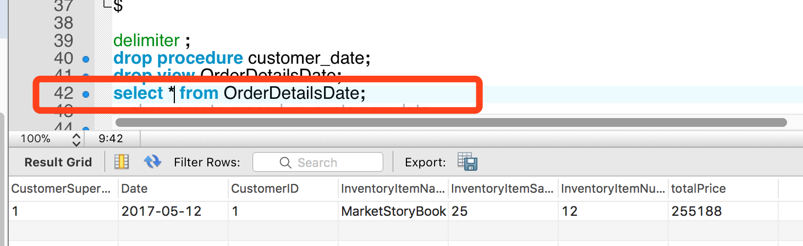
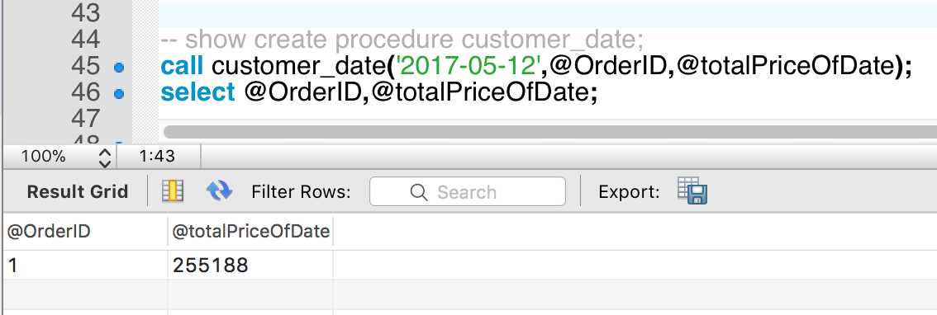

Slide 44
Trigger

Slide 45
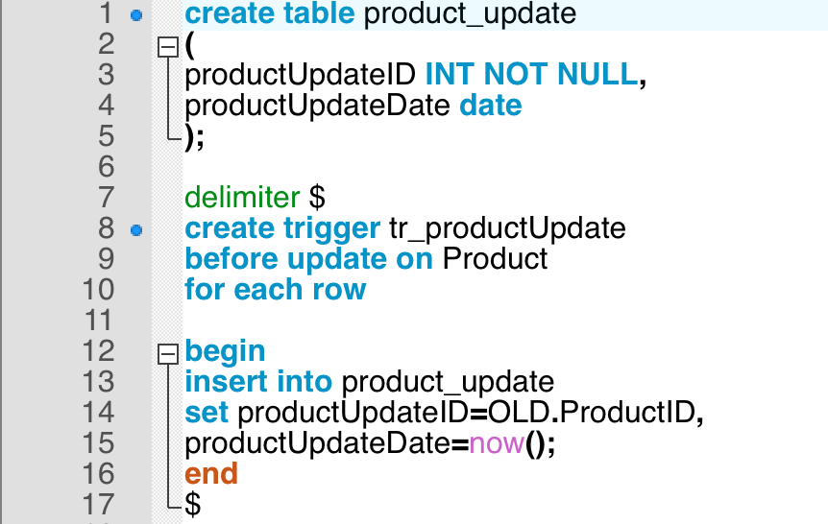
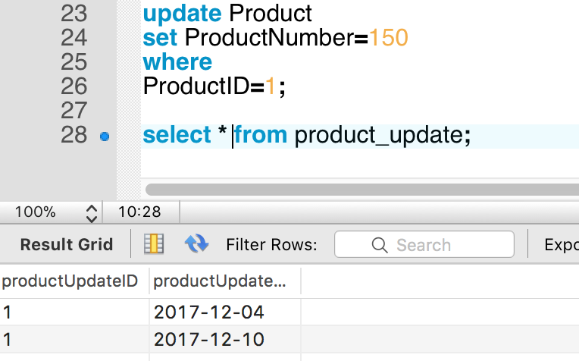
Trigger 1: Record Product Information
Record Product Information if it is updated

Slide 46
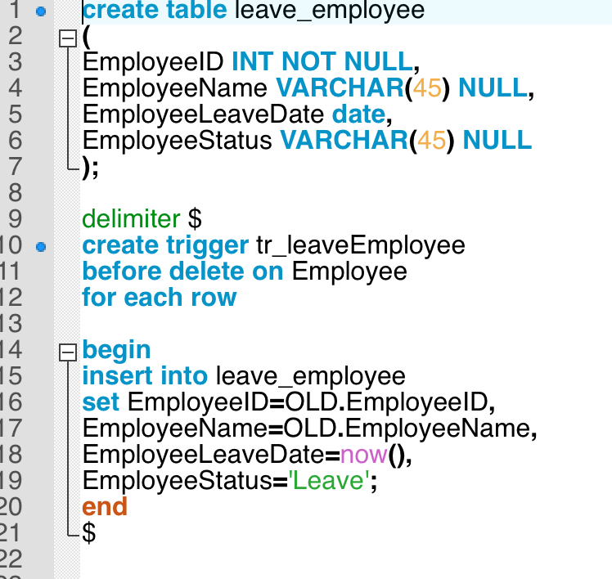
Trigger 2: Record Employee Information
Record Employee Information if he/she left the supermarket

Slide 47
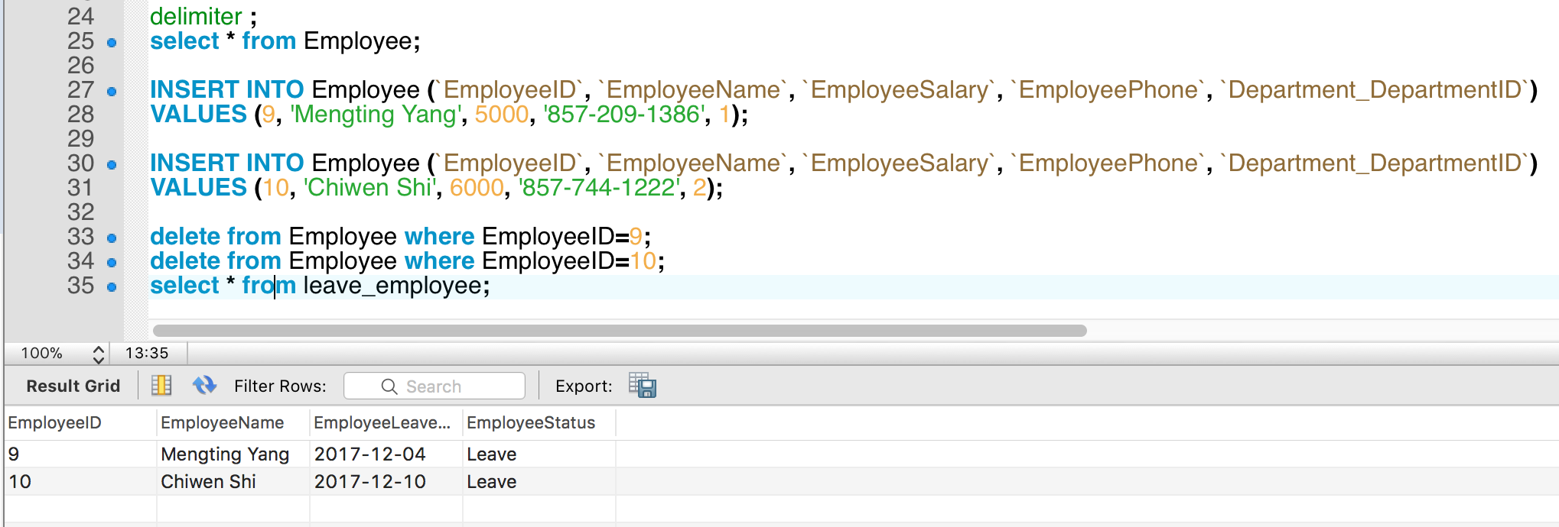

Slide 48
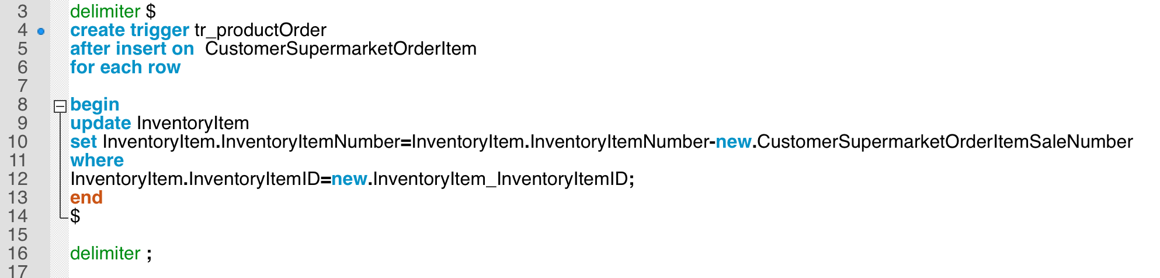
Trigger 3: Update Inventory Number
Reduce the Inventory Number if Customer buy new things

Slide 49
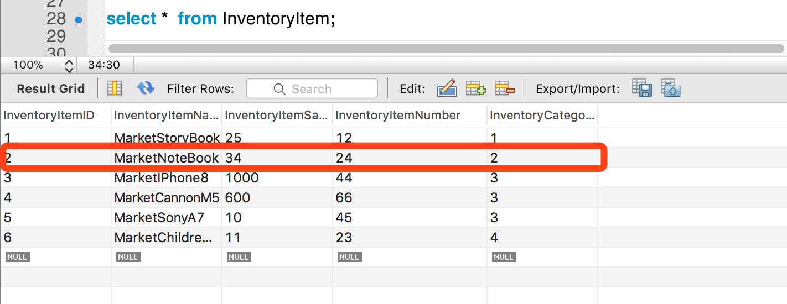
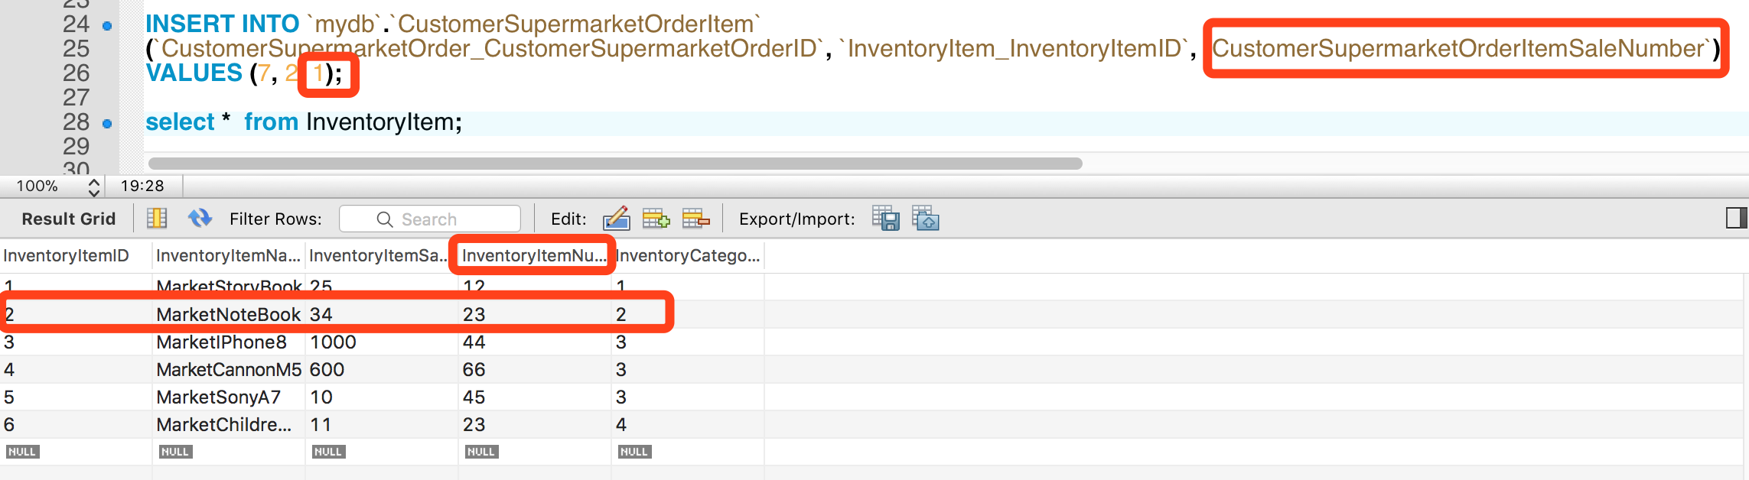

Slide 50
THANK
YOU

